Slide 1



What we know
(don’t)
^
… about being productive and finding meaning at work
dishopch@msu.edu
Cdishop
Christopher R. Dishop

Slide 2
Agenda
Selection
Teams
Methods
Meaningful
Work
Performance
Diversity

Slide 3
Agenda
What we know
Selection
Teams
Methods
Meaningful
Work
Performance
Diversity

Slide 4
Agenda
What we know
Selection
Teams
Methods
Meaningful
Work
Performance
Diversity
What we don’t know

Slide 5
Agenda
MSU | Grad School | Career Path

Slide 6
Maybe Caveat
Correlational. External validity.
Low on data, high on buzzwords. I was going to present my dissertation
But I was asked to keep it basic. So I’m keeping it basic.

Slide 7
What we know about finding meaning and being productive at work

Slide 8
MEANINGFUL WORK

Slide 9
MEANINGFUL WORK
- Engaged
- Satisfied

Slide 10
Meaningful Work
What we know

Slide 11
Meaningful Work
What we know
Job Characteristics Model

Slide 12
Meaningful Work
Autonomy
Identity
Significance
Feedback
Skill Variety
What we know

Slide 13
Meaningful Work
Autonomy
Identity
Significance
Feedback
Skill Variety
What we know

Slide 14
Meaningful Work
Autonomy
Identity
Significance
Feedback
Skill Variety
What we know

Slide 15
Meaningful Work
Autonomy
Identity
Significance
Feedback
Skill Variety
What we know

Slide 16
Meaningful Work
Autonomy
Identity
Significance
Feedback
Skill Variety
What we know

Slide 17
Meaningful Work
Autonomy
Identity
Significance
Feedback
Skill Variety
What we know

Slide 18
Meaningful Work
Autonomy
Identity
Significance
Feedback
Skill Variety
Uniquely Valuable
What we know

Slide 19

Meaningful Work
Autonomy
Identity
Significance
Feedback
Skill Variety
Uniquely Valuable
What we know

Slide 20
Meaningful Work
What we know
☹️

Slide 21
Meaningful Work
Follow your passion
What we know
☹️

Slide 22
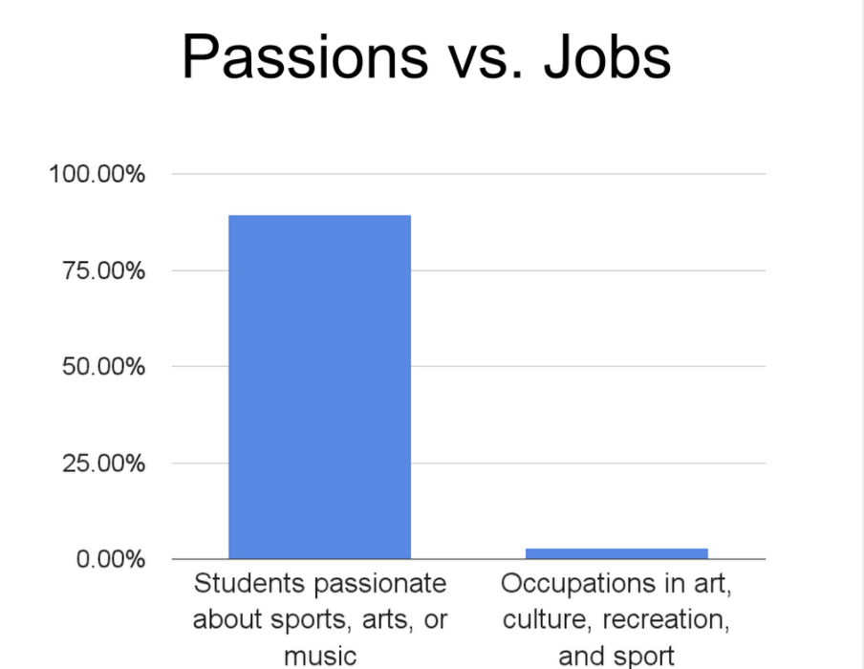
Meaningful Work
Follow your passion
What we know
☹️

Slide 23
Meaningful Work
Follow your passion
What we know
☹️
“We are all passionate about music, art, sex, and sports. There are no jobs in those industries.” - Freakonomics

Slide 24
Meaningful Work
Follow your passion
Commute time
What we know
☹️
☹️

Slide 25
Meaningful Work
What we don’t know

Slide 26
Meaningful Work
Limits
Technology & Social Media
What we don’t know

Slide 27
Individual Performance & Career Success

Slide 28
Individual Performance & Career Success
- Effective
- Ladder

Slide 29
Individual Success
What we know
Notes:
Agent. Environment.
Self Regulation.
Sklls – learning, writing, communicating

Slide 30
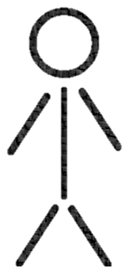
Individual Success
What we know
Notes:
Self regulation. Connects person and environment. Something I study. What is the link between someone performing, the feedback he gets from the envioronment, and so on.

Slide 31
Individual Success
What we know
Cognitive Ability
Notes:
Self regulation. Connects person and environment. Something I study. What is the link between someone performing, the feedback he gets from the envioronment, and so on.

Slide 32
Individual Success
What we know
Cognitive Ability
Assertive
Optimism
Conscientiousness
Notes:
Self regulation. Connects person and environment. Something I study. What is the link between someone performing, the feedback he gets from the envioronment, and so on.

Slide 33
Individual Success
What we know
Cognitive Ability
Assertive
Optimism
Conscientiousness
Learning, Writing, Communicating
Notes:
Self regulation. Connects person and environment. Something I study. What is the link between someone performing, the feedback he gets from the envioronment, and so on.

Slide 34
Individual Success
What we know
Cognitive Ability
Assertive
Optimism
Conscientiousness
Learning, Writing, Communicating
Parents
Social Support
Notes:
Self regulation. Connects person and environment. Something I study. What is the link between someone performing, the feedback he gets from the envioronment, and so on.

Slide 35
Individual Success
What we know
Human Capital Investments
Cognitive Ability
Assertive
Optimism
Conscientiousness
Learning, Writing, Communicating
Parents
Social Support
Notes:
Self regulation. Connects person and environment. Something I study. What is the link between someone performing, the feedback he gets from the envioronment, and so on.

Slide 36
Individual Success
What we know
Environment
State
Notes:
Self regulation. Connects person and environment. Something I study. What is the link between someone performing, the feedback he gets from the envioronment, and so on.
Goals. Rewards

Slide 37
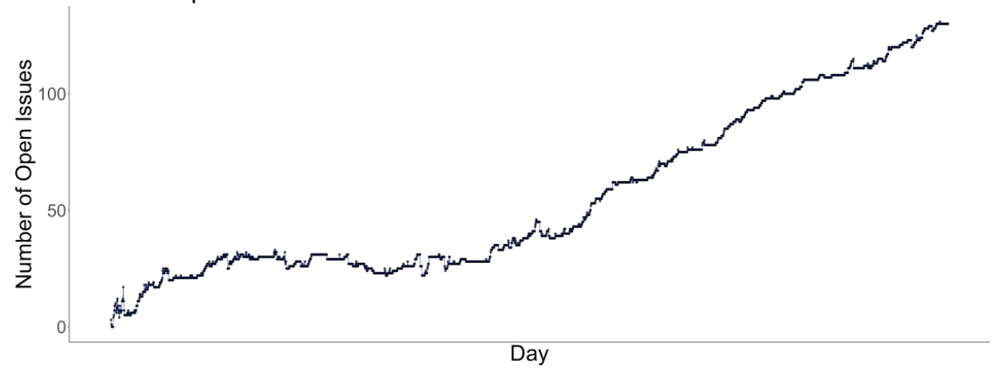
Individual Success
What we know
Notes:
Self regulation. Connects person and environment. Something I study. What is the link between someone performing, the feedback he gets from the envioronment, and so on.

Slide 38
Individual Success
What we don’t know
Notes:
Self regulation. Connects person and environment. Something I study. What is the link between someone performing, the feedback he gets from the envioronment, and so on.

Slide 39
Individual Success
Translating
What we don’t know

Slide 40
Individual Success
Translating (Scientist Practitioner Gap)
Protean & Boundaryless
What we don’t know

Slide 41
Team Performance

Slide 42
Team Performance
- Effective

Slide 43
Team Performance
What we know
Notes:
Henry Ford broke the assembly task into 84 discrete steps and trained workers to do just one step to increase his factories’ productivity. This reduced the production time of a car from 12.5 hours to 93 minutes. Production figures compiled from the Model T Comprehensive Encyclopedia show that production before the assembly line was introduced in 1913 averaged 68,773 cars per year. In 1913, production increased to 170,211 cars in a year (McCalley, 1989).
Each worker focuses on one task and specializes
No transition times
By focusing on one task, you can be creative and change it slightly to make it better

Slide 44
Team Performance
Process Loss
What we know
Notes:
Henry Ford broke the assembly task into 84 discrete steps and trained workers to do just one step to increase his factories’ productivity. This reduced the production time of a car from 12.5 hours to 93 minutes. Production figures compiled from the Model T Comprehensive Encyclopedia show that production before the assembly line was introduced in 1913 averaged 68,773 cars per year. In 1913, production increased to 170,211 cars in a year (McCalley, 1989).
Each worker focuses on one task and specializes
No transition times
By focusing on one task, you can be creative and change it slightly to make it better

Slide 45
Team Performance
Process Loss
What we know
Notes:
Henry Ford broke the assembly task into 84 discrete steps and trained workers to do just one step to increase his factories’ productivity. This reduced the production time of a car from 12.5 hours to 93 minutes. Production figures compiled from the Model T Comprehensive Encyclopedia show that production before the assembly line was introduced in 1913 averaged 68,773 cars per year. In 1913, production increased to 170,211 cars in a year (McCalley, 1989).
Each worker focuses on one task and specializes
No transition times
By focusing on one task, you can be creative and change it slightly to make it better

Slide 46

Team Performance
Process Loss
Division Of Labor
What we know
Notes:
Henry Ford broke the assembly task into 84 discrete steps and trained workers to do just one step to increase his factories’ productivity. This reduced the production time of a car from 12.5 hours to 93 minutes. Production figures compiled from the Model T Comprehensive Encyclopedia show that production before the assembly line was introduced in 1913 averaged 68,773 cars per year. In 1913, production increased to 170,211 cars in a year (McCalley, 1989).
Each worker focuses on one task and specializes
No transition times
By focusing on one task, you can be creative and change it slightly to make it better

Slide 47
Team Performance
Process Loss
Division Of Labor
What we know
Notes:
Henry Ford broke the assembly task into 84 discrete steps and trained workers to do just one step to increase his factories’ productivity. This reduced the production time of a car from 12.5 hours to 93 minutes. Production figures compiled from the Model T Comprehensive Encyclopedia show that production before the assembly line was introduced in 1913 averaged 68,773 cars per year. In 1913, production increased to 170,211 cars in a year (McCalley, 1989).
Each worker focuses on one task and specializes
No transition times
By focusing on one task, you can be creative and change it slightly to make it better

Slide 48
Team Performance
Process Loss
Division Of Labor
What we know
Hours to production
Notes:
Henry Ford broke the assembly task into 84 discrete steps and trained workers to do just one step to increase his factories’ productivity. This reduced the production time of a car from 12.5 hours to 93 minutes. Production figures compiled from the Model T Comprehensive Encyclopedia show that production before the assembly line was introduced in 1913 averaged 68,773 cars per year. In 1913, production increased to 170,211 cars in a year (McCalley, 1989).
Each worker focuses on one task and specializes
No transition times
By focusing on one task, you can be creative and change it slightly to make it better

Slide 49
Team Performance
Process Loss
Division Of Labor
What we know
13
Hours to production
1
Notes:
Henry Ford broke the assembly task into 84 discrete steps and trained workers to do just one step to increase his factories’ productivity. This reduced the production time of a car from 12.5 hours to 93 minutes. Production figures compiled from the Model T Comprehensive Encyclopedia show that production before the assembly line was introduced in 1913 averaged 68,773 cars per year. In 1913, production increased to 170,211 cars in a year (McCalley, 1989).
Each worker focuses on one task and specializes
No transition times
By focusing on one task, you can be creative and change it slightly to make it better

Slide 50
Team Performance
Process Loss
Division Of Labor
What we know
13
No
Assembly
Line
Hours to production
1
Notes:
Henry Ford broke the assembly task into 84 discrete steps and trained workers to do just one step to increase his factories’ productivity. This reduced the production time of a car from 12.5 hours to 93 minutes. Production figures compiled from the Model T Comprehensive Encyclopedia show that production before the assembly line was introduced in 1913 averaged 68,773 cars per year. In 1913, production increased to 170,211 cars in a year (McCalley, 1989).
Each worker focuses on one task and specializes
No transition times
By focusing on one task, you can be creative and change it slightly to make it better

Slide 51
Team Performance
Process Loss
Division Of Labor
What we know
13
No
Assembly
Line
Hours to production
1
Assembly Line
Notes:
Henry Ford broke the assembly task into 84 discrete steps and trained workers to do just one step to increase his factories’ productivity. This reduced the production time of a car from 12.5 hours to 93 minutes. Production figures compiled from the Model T Comprehensive Encyclopedia show that production before the assembly line was introduced in 1913 averaged 68,773 cars per year. In 1913, production increased to 170,211 cars in a year (McCalley, 1989).
Each worker focuses on one task and specializes
No transition times
By focusing on one task, you can be creative and change it slightly to make it better

Slide 52
Team Performance
Process Loss
Division Of Labor
Wisdom Of Crowds
What we know
Notes:
Henry Ford broke the assembly task into 84 discrete steps and trained workers to do just one step to increase his factories’ productivity. This reduced the production time of a car from 12.5 hours to 93 minutes. Production figures compiled from the Model T Comprehensive Encyclopedia show that production before the assembly line was introduced in 1913 averaged 68,773 cars per year. In 1913, production increased to 170,211 cars in a year (McCalley, 1989).
Each worker focuses on one task and specializes
No transition times
By focusing on one task, you can be creative and change it slightly to make it better

Slide 53

Team Performance
Process Loss
Division Of Labor
Wisdom Of Crowds
What we know
Notes:
Henry Ford broke the assembly task into 84 discrete steps and trained workers to do just one step to increase his factories’ productivity. This reduced the production time of a car from 12.5 hours to 93 minutes. Production figures compiled from the Model T Comprehensive Encyclopedia show that production before the assembly line was introduced in 1913 averaged 68,773 cars per year. In 1913, production increased to 170,211 cars in a year (McCalley, 1989).
Each worker focuses on one task and specializes
No transition times
By focusing on one task, you can be creative and change it slightly to make it better

Slide 54
Team Performance
Process Loss
Division Of Labor
Wisdom Of Crowds
What we know
1900
2000
1100
1200
Notes:
Henry Ford broke the assembly task into 84 discrete steps and trained workers to do just one step to increase his factories’ productivity. This reduced the production time of a car from 12.5 hours to 93 minutes. Production figures compiled from the Model T Comprehensive Encyclopedia show that production before the assembly line was introduced in 1913 averaged 68,773 cars per year. In 1913, production increased to 170,211 cars in a year (McCalley, 1989).
Each worker focuses on one task and specializes
No transition times
By focusing on one task, you can be creative and change it slightly to make it better

Slide 55
Team Performance
Process Loss
Division Of Labor
Wisdom Of Crowds
What we know
1900
2000
1100
1200
Notes:
Henry Ford broke the assembly task into 84 discrete steps and trained workers to do just one step to increase his factories’ productivity. This reduced the production time of a car from 12.5 hours to 93 minutes. Production figures compiled from the Model T Comprehensive Encyclopedia show that production before the assembly line was introduced in 1913 averaged 68,773 cars per year. In 1913, production increased to 170,211 cars in a year (McCalley, 1989).
Each worker focuses on one task and specializes
No transition times
By focusing on one task, you can be creative and change it slightly to make it better

Slide 56
Team Performance
Process Loss
Division Of Labor
Wisdom Of Crowds
What we know
1900
2000
1100
1200
1550
Notes:
Henry Ford broke the assembly task into 84 discrete steps and trained workers to do just one step to increase his factories’ productivity. This reduced the production time of a car from 12.5 hours to 93 minutes. Production figures compiled from the Model T Comprehensive Encyclopedia show that production before the assembly line was introduced in 1913 averaged 68,773 cars per year. In 1913, production increased to 170,211 cars in a year (McCalley, 1989).
Each worker focuses on one task and specializes
No transition times
By focusing on one task, you can be creative and change it slightly to make it better

Slide 57
Team Performance
Process Loss
Division Of Labor
Wisdom Of Crowds
What we know
1900
2000
1100
1200
1550 =
Notes:
Henry Ford broke the assembly task into 84 discrete steps and trained workers to do just one step to increase his factories’ productivity. This reduced the production time of a car from 12.5 hours to 93 minutes. Production figures compiled from the Model T Comprehensive Encyclopedia show that production before the assembly line was introduced in 1913 averaged 68,773 cars per year. In 1913, production increased to 170,211 cars in a year (McCalley, 1989).
Each worker focuses on one task and specializes
No transition times
By focusing on one task, you can be creative and change it slightly to make it better

Slide 58
Team Performance
Process Loss
Division Of Labor
Wisdom Of Crowds
Diversity
What we know
Notes:
Henry Ford broke the assembly task into 84 discrete steps and trained workers to do just one step to increase his factories’ productivity. This reduced the production time of a car from 12.5 hours to 93 minutes. Production figures compiled from the Model T Comprehensive Encyclopedia show that production before the assembly line was introduced in 1913 averaged 68,773 cars per year. In 1913, production increased to 170,211 cars in a year (McCalley, 1989).
Each worker focuses on one task and specializes
No transition times
By focusing on one task, you can be creative and change it slightly to make it better

Slide 59
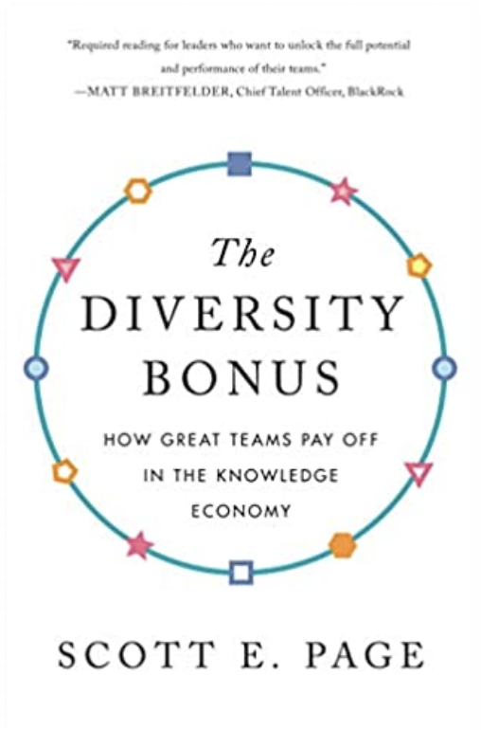

Team Performance
Process Loss
Division Of Labor
Wisdom Of Crowds
Diversity
What we know
Notes:
Henry Ford broke the assembly task into 84 discrete steps and trained workers to do just one step to increase his factories’ productivity. This reduced the production time of a car from 12.5 hours to 93 minutes. Production figures compiled from the Model T Comprehensive Encyclopedia show that production before the assembly line was introduced in 1913 averaged 68,773 cars per year. In 1913, production increased to 170,211 cars in a year (McCalley, 1989).
Each worker focuses on one task and specializes
No transition times
By focusing on one task, you can be creative and change it slightly to make it better

Slide 60
Team Performance
Process Loss
Division Of Labor
Wisdom Of Crowds
Diversity
Levers
What we know
Notes:
Henry Ford broke the assembly task into 84 discrete steps and trained workers to do just one step to increase his factories’ productivity. This reduced the production time of a car from 12.5 hours to 93 minutes. Production figures compiled from the Model T Comprehensive Encyclopedia show that production before the assembly line was introduced in 1913 averaged 68,773 cars per year. In 1913, production increased to 170,211 cars in a year (McCalley, 1989).
Each worker focuses on one task and specializes
No transition times
By focusing on one task, you can be creative and change it slightly to make it better

Slide 61
Team Performance
Process Loss
Division Of Labor
Wisdom Of Crowds
Diversity
Levers
What we know
Shared Vision | Transactive Memory | Leadership
Notes:
Henry Ford broke the assembly task into 84 discrete steps and trained workers to do just one step to increase his factories’ productivity. This reduced the production time of a car from 12.5 hours to 93 minutes. Production figures compiled from the Model T Comprehensive Encyclopedia show that production before the assembly line was introduced in 1913 averaged 68,773 cars per year. In 1913, production increased to 170,211 cars in a year (McCalley, 1989).
Each worker focuses on one task and specializes
No transition times
By focusing on one task, you can be creative and change it slightly to make it better

Slide 62
Team Performance
Process Loss
Division Of Labor
Wisdom Of Crowds
Diversity
Levers
Cooperation
What we know
Notes:
Henry Ford broke the assembly task into 84 discrete steps and trained workers to do just one step to increase his factories’ productivity. This reduced the production time of a car from 12.5 hours to 93 minutes. Production figures compiled from the Model T Comprehensive Encyclopedia show that production before the assembly line was introduced in 1913 averaged 68,773 cars per year. In 1913, production increased to 170,211 cars in a year (McCalley, 1989).
Each worker focuses on one task and specializes
No transition times
By focusing on one task, you can be creative and change it slightly to make it better

Slide 63
Dishop, C. R., & DeShon, R. P. (2020). What is the critical mass of help? A potential resolution to a paradox on citizenship and organizational performance. Computational & Mathematical Organization Theory, 1-15.
Team Performance
What we know
Notes:
Henry Ford broke the assembly task into 84 discrete steps and trained workers to do just one step to increase his factories’ productivity. This reduced the production time of a car from 12.5 hours to 93 minutes. Production figures compiled from the Model T Comprehensive Encyclopedia show that production before the assembly line was introduced in 1913 averaged 68,773 cars per year. In 1913, production increased to 170,211 cars in a year (McCalley, 1989).
Each worker focuses on one task and specializes
No transition times
By focusing on one task, you can be creative and change it slightly to make it better

Slide 64
Dishop, C. R., & DeShon, R. P. (2020). What is the critical mass of help? A potential resolution to a paradox on citizenship and organizational performance. Computational & Mathematical Organization Theory, 1-15.
Team Performance
What we know
Helping
Performing
Notes:
Henry Ford broke the assembly task into 84 discrete steps and trained workers to do just one step to increase his factories’ productivity. This reduced the production time of a car from 12.5 hours to 93 minutes. Production figures compiled from the Model T Comprehensive Encyclopedia show that production before the assembly line was introduced in 1913 averaged 68,773 cars per year. In 1913, production increased to 170,211 cars in a year (McCalley, 1989).
Each worker focuses on one task and specializes
No transition times
By focusing on one task, you can be creative and change it slightly to make it better

Slide 65
Dishop, C. R., & DeShon, R. P. (2020). What is the critical mass of help? A potential resolution to a paradox on citizenship and organizational performance. Computational & Mathematical Organization Theory, 1-15.
Team Performance
What we know
Helping
Performing
Collective Performance
Notes:
Henry Ford broke the assembly task into 84 discrete steps and trained workers to do just one step to increase his factories’ productivity. This reduced the production time of a car from 12.5 hours to 93 minutes. Production figures compiled from the Model T Comprehensive Encyclopedia show that production before the assembly line was introduced in 1913 averaged 68,773 cars per year. In 1913, production increased to 170,211 cars in a year (McCalley, 1989).
Each worker focuses on one task and specializes
No transition times
By focusing on one task, you can be creative and change it slightly to make it better

Slide 66
Dishop, C. R., & DeShon, R. P. (2020). What is the critical mass of help? A potential resolution to a paradox on citizenship and organizational performance. Computational & Mathematical Organization Theory, 1-15.
Team Performance
What we know
Helping
Performing
Collective Performance
# People Helping
Notes:
Henry Ford broke the assembly task into 84 discrete steps and trained workers to do just one step to increase his factories’ productivity. This reduced the production time of a car from 12.5 hours to 93 minutes. Production figures compiled from the Model T Comprehensive Encyclopedia show that production before the assembly line was introduced in 1913 averaged 68,773 cars per year. In 1913, production increased to 170,211 cars in a year (McCalley, 1989).
Each worker focuses on one task and specializes
No transition times
By focusing on one task, you can be creative and change it slightly to make it better

Slide 67
Dishop, C. R., & DeShon, R. P. (2020). What is the critical mass of help? A potential resolution to a paradox on citizenship and organizational performance. Computational & Mathematical Organization Theory, 1-15.
Team Performance
What we know
Helping
Performing
Collective Performance
# People Helping
Notes:
Henry Ford broke the assembly task into 84 discrete steps and trained workers to do just one step to increase his factories’ productivity. This reduced the production time of a car from 12.5 hours to 93 minutes. Production figures compiled from the Model T Comprehensive Encyclopedia show that production before the assembly line was introduced in 1913 averaged 68,773 cars per year. In 1913, production increased to 170,211 cars in a year (McCalley, 1989).
Each worker focuses on one task and specializes
No transition times
By focusing on one task, you can be creative and change it slightly to make it better

Slide 68
Dishop, C. R., & DeShon, R. P. (2020). What is the critical mass of help? A potential resolution to a paradox on citizenship and organizational performance. Computational & Mathematical Organization Theory, 1-15.
Team Performance
What we know
Helping
Performing
Collective Performance
# People Helping
Notes:
Henry Ford broke the assembly task into 84 discrete steps and trained workers to do just one step to increase his factories’ productivity. This reduced the production time of a car from 12.5 hours to 93 minutes. Production figures compiled from the Model T Comprehensive Encyclopedia show that production before the assembly line was introduced in 1913 averaged 68,773 cars per year. In 1913, production increased to 170,211 cars in a year (McCalley, 1989).
Each worker focuses on one task and specializes
No transition times
By focusing on one task, you can be creative and change it slightly to make it better

Slide 69
Dishop, C. R., & DeShon, R. P. (2020). What is the critical mass of help? A potential resolution to a paradox on citizenship and organizational performance. Computational & Mathematical Organization Theory, 1-15.
Team Performance
What we know
Helping
Performing
Collective Performance
# People Helping
Notes:
Henry Ford broke the assembly task into 84 discrete steps and trained workers to do just one step to increase his factories’ productivity. This reduced the production time of a car from 12.5 hours to 93 minutes. Production figures compiled from the Model T Comprehensive Encyclopedia show that production before the assembly line was introduced in 1913 averaged 68,773 cars per year. In 1913, production increased to 170,211 cars in a year (McCalley, 1989).
Each worker focuses on one task and specializes
No transition times
By focusing on one task, you can be creative and change it slightly to make it better

Slide 70
Dishop, C. R., & DeShon, R. P. (2020). What is the critical mass of help? A potential resolution to a paradox on citizenship and organizational performance. Computational & Mathematical Organization Theory, 1-15.
Team Performance
What we know
Helping
Performing
Collective Performance
# People Helping
Notes:
Henry Ford broke the assembly task into 84 discrete steps and trained workers to do just one step to increase his factories’ productivity. This reduced the production time of a car from 12.5 hours to 93 minutes. Production figures compiled from the Model T Comprehensive Encyclopedia show that production before the assembly line was introduced in 1913 averaged 68,773 cars per year. In 1913, production increased to 170,211 cars in a year (McCalley, 1989).
Each worker focuses on one task and specializes
No transition times
By focusing on one task, you can be creative and change it slightly to make it better

Slide 71
Dishop, C. R., & DeShon, R. P. (2020). What is the critical mass of help? A potential resolution to a paradox on citizenship and organizational performance. Computational & Mathematical Organization Theory, 1-15.
Team Performance
What we know
Helping
Performing
Collective Performance
# People Helping
Notes:
Henry Ford broke the assembly task into 84 discrete steps and trained workers to do just one step to increase his factories’ productivity. This reduced the production time of a car from 12.5 hours to 93 minutes. Production figures compiled from the Model T Comprehensive Encyclopedia show that production before the assembly line was introduced in 1913 averaged 68,773 cars per year. In 1913, production increased to 170,211 cars in a year (McCalley, 1989).
Each worker focuses on one task and specializes
No transition times
By focusing on one task, you can be creative and change it slightly to make it better

Slide 72
Dishop, C. R., & DeShon, R. P. (2020). What is the critical mass of help? A potential resolution to a paradox on citizenship and organizational performance. Computational & Mathematical Organization Theory, 1-15.
Team Performance
What we know
Helping
Performing
Collective Performance
# People Helping
Notes:
Henry Ford broke the assembly task into 84 discrete steps and trained workers to do just one step to increase his factories’ productivity. This reduced the production time of a car from 12.5 hours to 93 minutes. Production figures compiled from the Model T Comprehensive Encyclopedia show that production before the assembly line was introduced in 1913 averaged 68,773 cars per year. In 1913, production increased to 170,211 cars in a year (McCalley, 1989).
Each worker focuses on one task and specializes
No transition times
By focusing on one task, you can be creative and change it slightly to make it better

Slide 73
Team Performance
What we don’t know
Notes:
Henry Ford broke the assembly task into 84 discrete steps and trained workers to do just one step to increase his factories’ productivity. This reduced the production time of a car from 12.5 hours to 93 minutes. Production figures compiled from the Model T Comprehensive Encyclopedia show that production before the assembly line was introduced in 1913 averaged 68,773 cars per year. In 1913, production increased to 170,211 cars in a year (McCalley, 1989).
Each worker focuses on one task and specializes
No transition times
By focusing on one task, you can be creative and change it slightly to make it better

Slide 74
Team Performance
Beyond lab
What we don’t know
Notes:
Henry Ford broke the assembly task into 84 discrete steps and trained workers to do just one step to increase his factories’ productivity. This reduced the production time of a car from 12.5 hours to 93 minutes. Production figures compiled from the Model T Comprehensive Encyclopedia show that production before the assembly line was introduced in 1913 averaged 68,773 cars per year. In 1913, production increased to 170,211 cars in a year (McCalley, 1989).
Each worker focuses on one task and specializes
No transition times
By focusing on one task, you can be creative and change it slightly to make it better

Slide 75
Team Performance
Beyond lab
Congruent explanations
What we don’t know
Notes:
This is the nice way to say it. The mean way to say it is that there is a tendency to provide explanations that are abstract, boring, and unhelpful. Not intellectually deep.

Slide 76
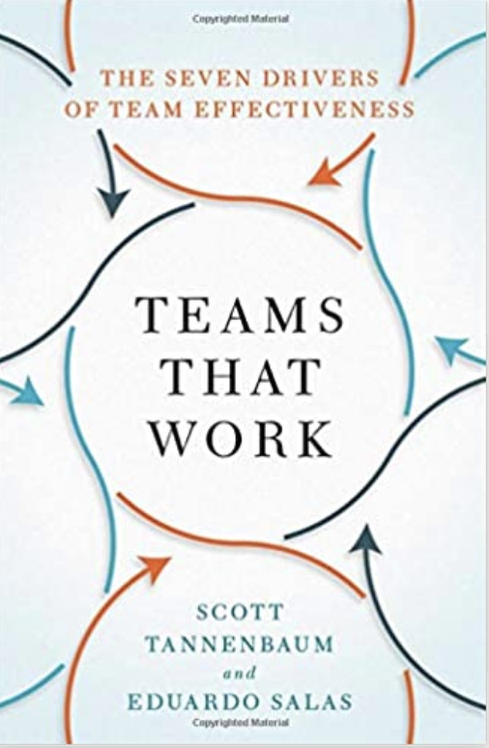
Team Performance
Beyond lab
Congruent explanations
What we don’t know

Slide 77
Team Performance
What we don’t know
Lever | Description
Conditions | Is the context favorable to performing well?

Slide 78
Methods

Slide 79
Methods
Scale Development
Measurement Invariance
Meta Analysis
Networks
Dynamics
Computational Modeling
Notes:
Henry Ford broke the assembly task into 84 discrete steps and trained workers to do just one step to increase his factories’ productivity. This reduced the production time of a car from 12.5 hours to 93 minutes. Production figures compiled from the Model T Comprehensive Encyclopedia show that production before the assembly line was introduced in 1913 averaged 68,773 cars per year. In 1913, production increased to 170,211 cars in a year (McCalley, 1989).
Each worker focuses on one task and specializes
No transition times
By focusing on one task, you can be creative and change it slightly to make it better

Slide 80
Team Performance
What we know
Notes:
Henry Ford broke the assembly task into 84 discrete steps and trained workers to do just one step to increase his factories’ productivity. This reduced the production time of a car from 12.5 hours to 93 minutes. Production figures compiled from the Model T Comprehensive Encyclopedia show that production before the assembly line was introduced in 1913 averaged 68,773 cars per year. In 1913, production increased to 170,211 cars in a year (McCalley, 1989).
Each worker focuses on one task and specializes
No transition times
By focusing on one task, you can be creative and change it slightly to make it better

Slide 81
TRANSITION HEADLINE
1
Let’s start with the first set of slides

Slide 82
Quotations are commonly printed as a means of inspiration and to invoke philosophical thoughts from the reader.

Slide 83
THIS IS A SLIDE TITLE
Here you have:
A list of items
And some text
But remember not to overload your slides with content
Your audience will listen to you or read the content, but won’t do both.

Slide 84
What we know
(don’t)
^
… about being productive and finding meaning at work
dishopch@msu.edu
Cdishop
Christopher R. Dishop

Slide 85
YOU CAN ALSO SPLIT YOUR CONTENT
White
Is the color of milk and fresh snow, the color produced by the combination of all the colors of the visible spectrum.
Black
Is the color of ebony and of outer space. It has been the symbolic color of elegance, solemnity and authority.

Slide 86
IN TWO OR THREE COLUMNS
Yellow
Is the color of gold, butter and ripe lemons. In the spectrum of visible light, yellow is found between green and orange.
Blue
Is the colour of the clear sky and the deep sea. It is located between violet and green on the optical spectrum.
Red
Is the color of blood, and because of this it has historically been associated with sacrifice, danger and courage.

Slide 87

A PICTURE IS WORTH A THOUSAND WORDS
A complex idea can be conveyed with just a single still image, namely making it possible to absorb large amounts of data quickly.

Slide 88

WANT BIG IMPACT?
Use big image.

Slide 89
USE CHARTS TO EXPLAIN YOUR IDEAS
White
Gray
Black

Slide 90
AND TABLES TO COMPARE DATA
 | A | B | C
Yellow | 10 | 20 | 7
Blue | 30 | 15 | 10
Orange | 5 | 24 | 16

Slide 91
MAPS
our office

Slide 92
89,526,124
Whoa! That’s a big number, aren’t you proud?

Slide 93
89,526,124$
185,244 users
100%
That’s a lot of money
And a lot of users
Total success!

Slide 94
OUR PROCESS IS EASY
First
Second
Last

Slide 95
LET’S REVIEW SOME CONCEPTS
Yellow
Is the color of gold, butter and ripe lemons. In the spectrum of visible light, yellow is found between green and orange.
Blue
Is the colour of the clear sky and the deep sea. It is located between violet and green on the optical spectrum.
Red
Is the color of blood, and because of this it has historically been associated with sacrifice, danger and courage.
Yellow
Is the color of gold, butter and ripe lemons. In the spectrum of visible light, yellow is found between green and orange.
Blue
Is the colour of the clear sky and the deep sea. It is located between violet and green on the optical spectrum.
Red
Is the color of blood, and because of this it has historically been associated with sacrifice, danger and courage.

Slide 96
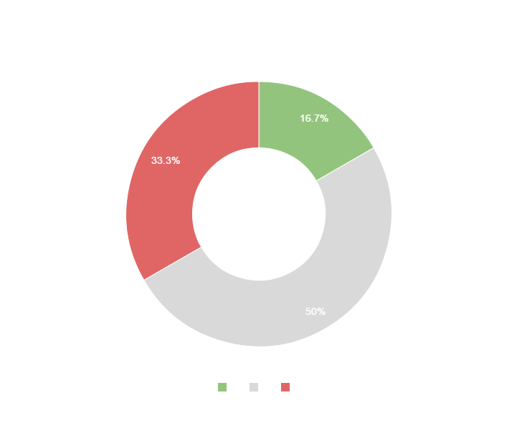
You can copy&paste graphs from Google Sheets

Slide 97
Place your screenshot here
MOBILE PROJECT
Show and explain your web, app or software projects using these gadget templates.

Slide 98
Place your screenshot here
TABLET PROJECT
Show and explain your web, app or software projects using these gadget templates.

Slide 99
Place your screenshot here
DESKTOP PROJECT
Show and explain your web, app or software projects using these gadget templates.

Slide 100
Thanks!
ANY QUESTIONS?
You can find me at
@username
user@mail.me

Slide 101
CREDITS
Special thanks to all the people who made and released these awesome resources for free:
Presentation template by SlidesCarnival
Photographs by Unsplash

Slide 102
PRESENTATION DESIGN
This presentations uses the following typographies and colors:
Titles & body copy: Quicksand
You can download the fonts on this page:
https://www.fontsquirrel.com/fonts/quicksand
Dark gray #2e3037
Aqua #39c0ba
Salmon #f35b69
Blue #6d9eeb
You don’t need to keep this slide in your presentation. It’s only here to serve you as a design guide if you need to create new slides or download the fonts to edit the presentation in PowerPoint®

Slide 103
SlidesCarnival icons are editable shapes.
This means that you can:
Resize them without losing quality.
Change line color, width and style.
Isn’t that nice? :)
Examples:

Slide 104
Diagrams and infographics

Slide 105
Now you can use any emoji as an icon!
And of course it resizes without losing quality and you can change the color.
How? Follow Google instructions https://twitter.com/googledocs/status/730087240156643328
😉
✋👆👉👍👤👦👧👨👩👪💃🏃💑❤😂😉😋😒😭👶😸🐟🍒🍔💣📌📖🔨🎃🎈🎨🏈🏰🌏🔌🔑 and many more...

Slide 106

Free templates for all your presentation needs
For PowerPoint and Google Slides
100% free for personal or commercial use
Ready to use, professional and customizable
Blow your audience away with attractive visuals

